Slide 1
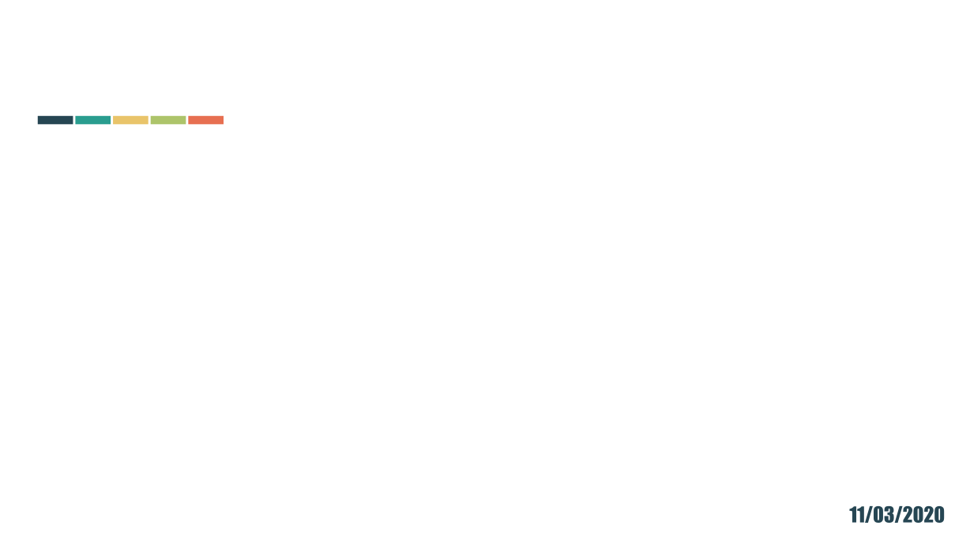
Python para Arquitetos e Urbanistas
fERNANDO ferraz rIBEIRO

Slide 2
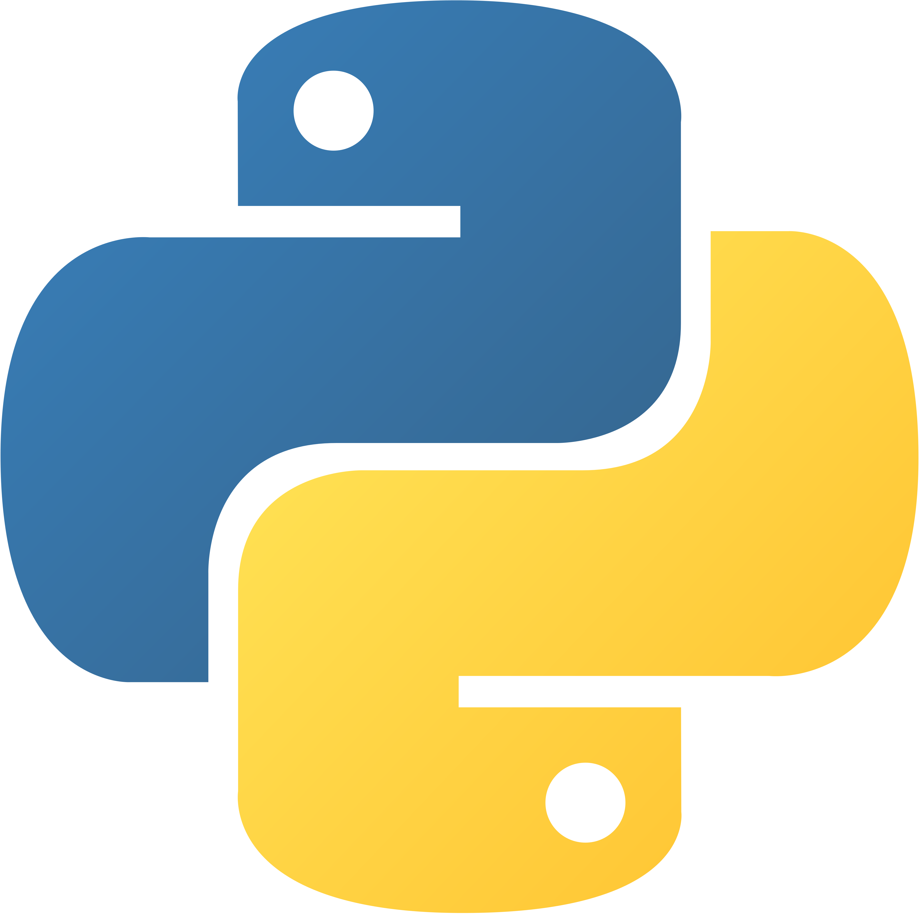
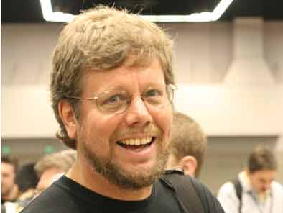
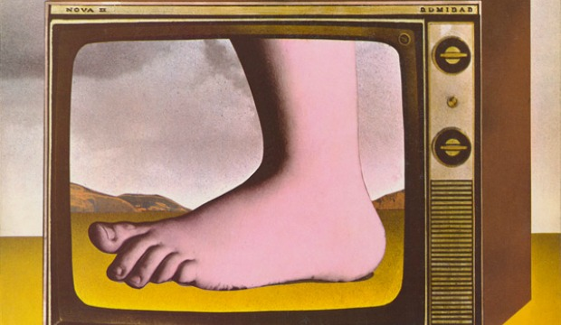
PYTHON
Linguagem de programação interpretada, multi-paradigma, multi-plataforma, orientada a objetos, imperativa, funcional, procedural, reflectiva e de código aberto.
Criada em 1989/1991 por Guido van Rossum
“I was looking for a "hobby" programming project that would keep me occupied during the week around Christmas. My office (a government-run research lab in Amsterdam) would be closed, but I had a home computer, and not much else on my hands. I decided to write an interpreter for the new scripting language I had been thinking about lately: a descendant of ABC that would appeal to Unix/C hackers. I chose Python as a working title for the project, being in a slightly irreverent mood (and a big fan of Monty Python's Flying Circus). “
Guido van Rossum

Slide 3
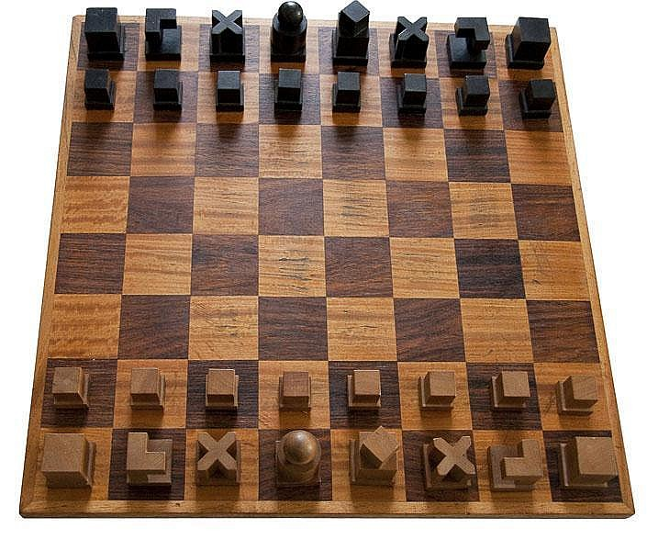
PYTHON
“ O conjunto de peças de xadrez Bauhaus de Josef Hartwig é um exemplo de design excelente: bonito, simples e claro. Guido von Rossum, filho de um arquiteto e irmão de um designer de fontes premiado, criou uma obra-prima do design de linguagens. Adoro ensinar Python porque ela é bonita, simples e clara.”
Luciano Ramalho. Python Fluente 2016

Slide 4





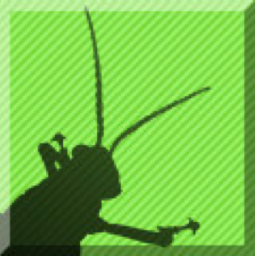



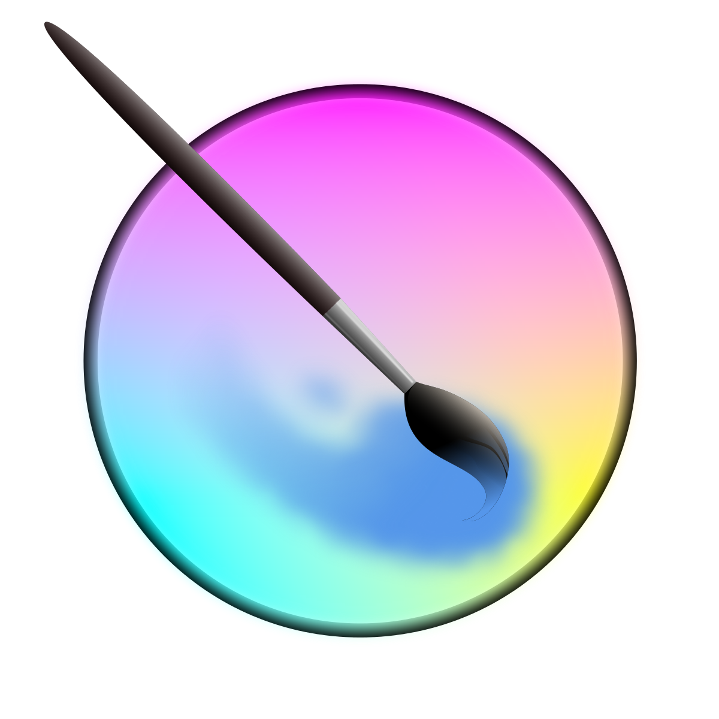







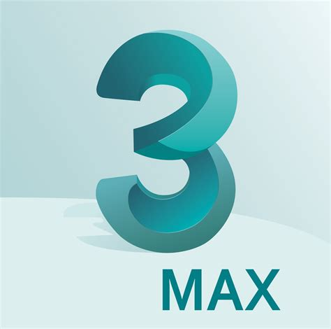


APIs PYTHON PARA ARQUITETOS
Blender
Maya
Rhino 3D
Grasshopper
FreeCad
ArcGIS
QGIS
Dynamo
FUSION
Vectorworks
IFC OPEN SHELL
KRITA
Revit
3DS MAX
UNIT
GODOT
INKSCAPE
GIMP

Slide 5
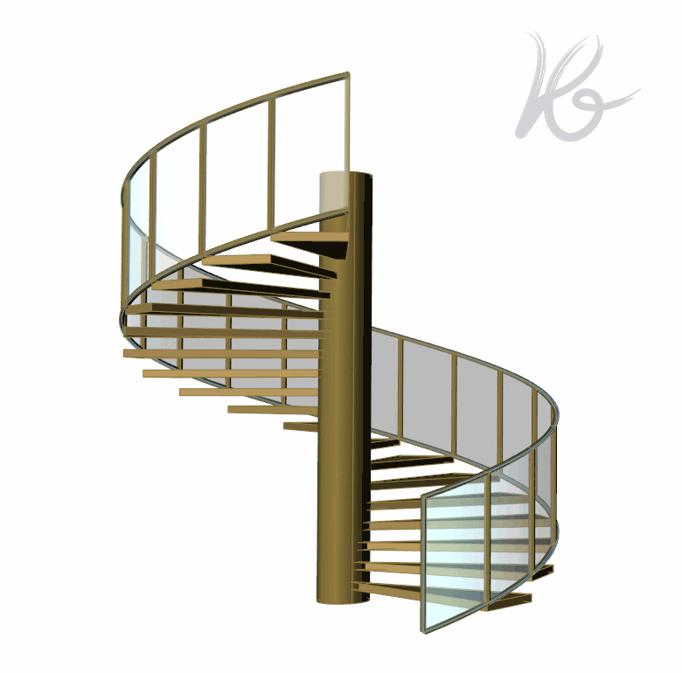
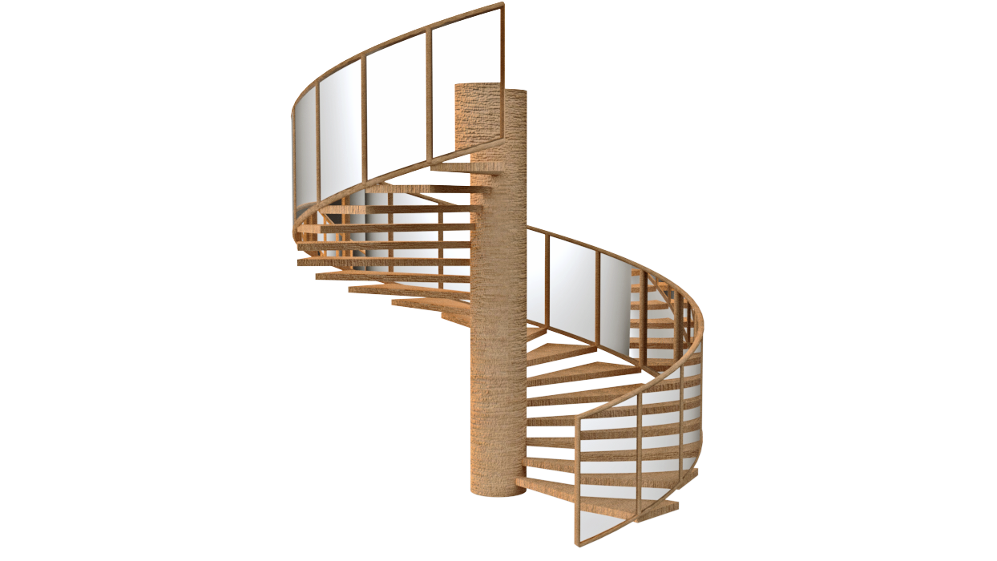
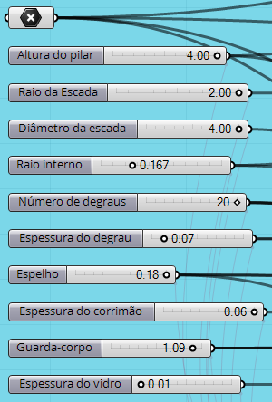
MODELAGEM PARAMÉTRICA

Slide 6
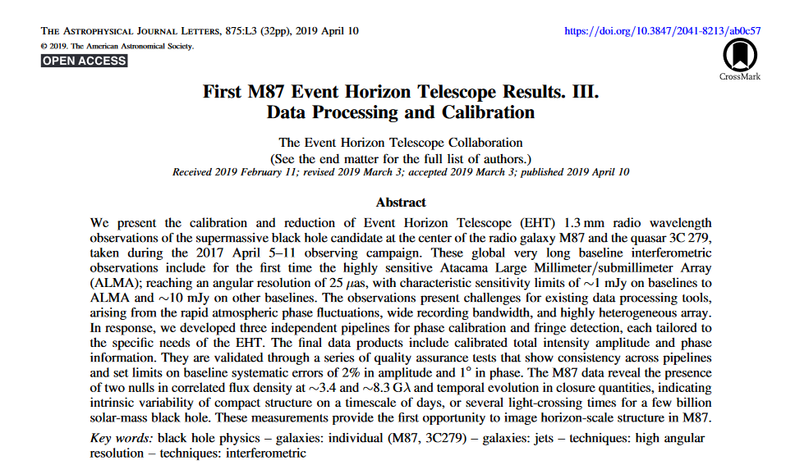
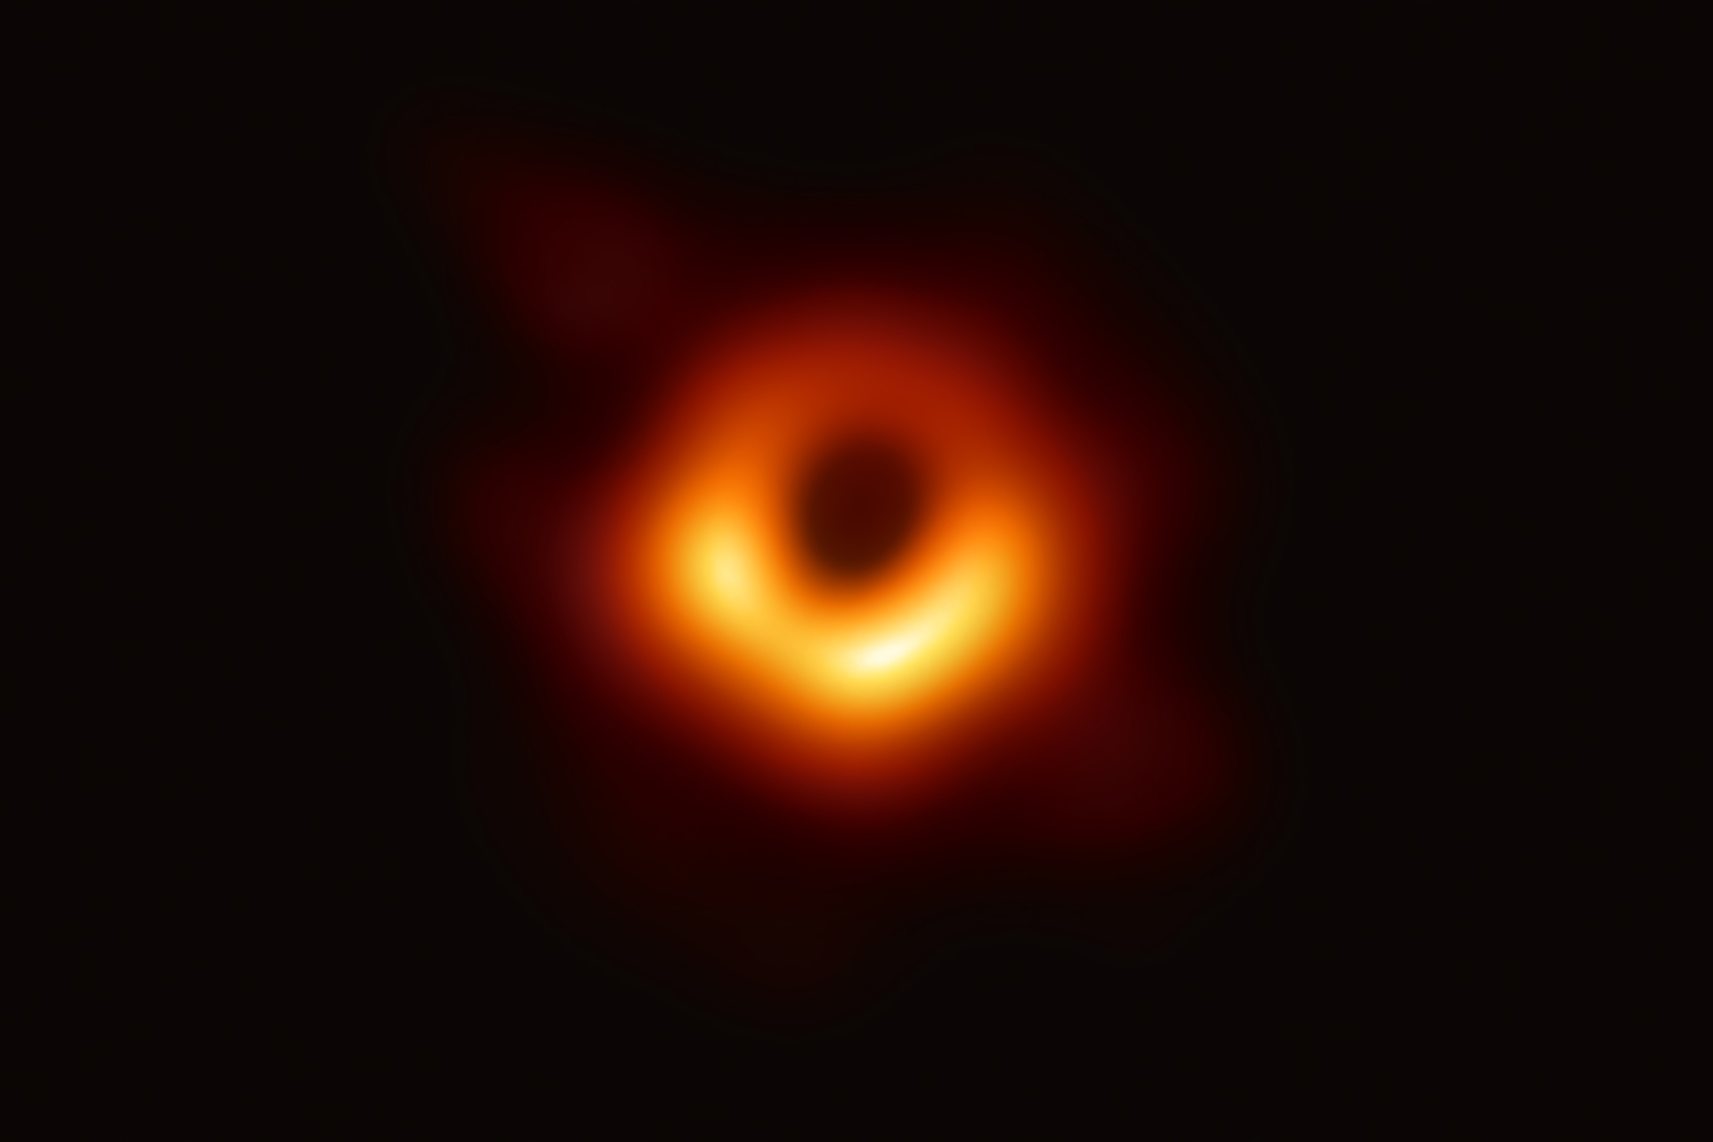
O UNIVERSÓ É O LIMITE
Python Used to Take Photo of Black Hole
https://www.blog.pythonlibrary.org/2019/04/11/python-used-to-take-photo-of-black-hole/

